Slide 1


Advanced Programming Techniques CS-307
Lab: C#
Instructor：Muhammad Rauf Sarwer

Slide 2


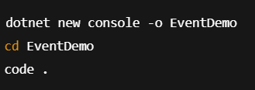
Setup
Open Visual Studio Code.
Make sure you have the .NET SDK installed. (Run dotnet --version in terminal to check.)
Create a new console project:
在此输入详细内容，建议：文字言简意赅，分点阐述核心观点；可适当调整字体、颜色、行间距等格式以突出重点
dotnet new console -o FirstStep
cd FirstStep
code .

Slide 3
Writing First C# Program
Code:
// A Hello World! program in C#.
using System;
namespace HelloWorld
{
class Hello
{
static void Main()
{
Console.WriteLine("Hello World!");
// Keep the console window open in debug mode.
Console.WriteLine("Press any key to exit.");
Console.ReadKey();
}
}
}
在此输入详细内容，建议：文字言简意赅，分点阐述核心观点；可适当调整字体、颜色、行间距等格式以突出重点

Slide 4
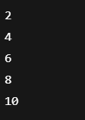
Activity No. 1
Print Array Elements
Create an array of 5 integers: { 2, 4, 6, 8, 10 }.
Use a for loop to print all elements.
在此输入详细内容，建议：文字言简意赅，分点阐述核心观点；可适当调整字体、颜色、行间距等格式以突出重点
Expected Output:
Notes:
int[] nums = { 2, 4, 6 };
Creates an array of integers called nums.
It holds 3 values: 2, 4, 6.
Indexing in C# always starts from 0:
nums[0] = 2
nums[1] = 4
nums[2] = 6
Console.WriteLine(nums[1]);
Prints the element at index 1.
Since arrays are 0-based, index 1 is the second element.
Output → 4.
Console.ReadKey();
Keeps the console open until a key is pressed.

Slide 5
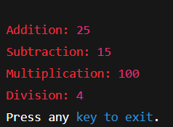
Activity No. 2
Basic Arithmetic Operations in C#
Create a new Console App project in Visual Studio.
Inside Main(), declare two integer variables, e.g., a = 20, b = 5.
Perform the following operations:
Addition (+)
Subtraction (-)
Multiplication (*)
Division (/)
在此输入详细内容，建议：文字言简意赅，分点阐述核心观点；可适当调整字体、颜色、行间距等格式以突出重点
Expected Output:
Notes:
int[] nums = { 2, 4, 6 };
Creates an array of integers called nums.
It holds 3 values: 2, 4, 6.
Indexing in C# always starts from 0:
nums[0] = 2
nums[1] = 4
nums[2] = 6
Console.WriteLine(nums[1]);
Prints the element at index 1.
Since arrays are 0-based, index 1 is the second element.
Output → 4.
Console.ReadKey();
Keeps the console open until a key is pressed.

Slide 6

Activity No. 3
Sum of Array Elements:
Using the same array, calculate the sum of all numbers
在此输入详细内容，建议：文字言简意赅，分点阐述核心观点；可适当调整字体、颜色、行间距等格式以突出重点
Expected Output:
Notes:
int[] nums = { 2, 4, 6 };
Creates an array of integers called nums.
It holds 3 values: 2, 4, 6.
Indexing in C# always starts from 0:
nums[0] = 2
nums[1] = 4
nums[2] = 6
Console.WriteLine(nums[1]);
Prints the element at index 1.
Since arrays are 0-based, index 1 is the second element.
Output → 4.
Console.ReadKey();
Keeps the console open until a key is pressed.

